Slide 1
Predictive Modeling of Heart Disease Using Machine Learning Algorithms: A Comparative Analysis
Presented by Group 5 Apurva Yadav
Aashima Gupta
Yash Patel
Simran Dabreo
Hamza Ali

Slide 2
Table of Contents
01
02
03
04
05
The Disease
Business Problem
Our Solution
06
Exploratory Data Analysis
Model Performance
Business Implications

Slide 3
01
The Disease

Slide 4
Introduction
Cardiovascular diseases remain the primary cause of global mortality, impacting populations worldwide irrespective of socioeconomic status.
Timely diagnosis and continuous monitoring are pivotal in reducing mortality rates associated with heart conditions.
Proposing the implementation of a machine learning-based model to detect potential heart failure.
Access to a comprehensive dataset comprising relevant variables is essential for accurately predicting the likelihood of heart failure.

Slide 5
02
Business Problem

Slide 6
In the realm of healthcare, particularly in the field of cardiology, there exists a pressing need for accurate and timely prediction of heart attacks. The ability to forecast the likelihood of a heart attack in individuals can significantly impact patient outcomes, healthcare resource allocation, and overall public health management
Given the gravity of the issue, there arises a crucial business problem:
How can healthcare providers leverage machine learning techniques to enhance the prediction of heart attacks and improve patient care?

Slide 7
03
Our Solution

Slide 8
Methodological Overview
Data Collection: Comprehensive dataset from medical records, clinical studies, and research databases.
Feature Selection: Carefully selected predictors including age, gender, blood pressure, cholesterol levels, family history, and lifestyle habits.
Model Training: Utilized logistic regression, decision trees, and random forests, partitioning data, fine-tuning parameters, and evaluating performance metrics.

Slide 9
Project Timeline
01
Data Collection
02
Data Preprocessing
03
Data Analysis
04
Training and Testing
05
Model Building

Slide 10
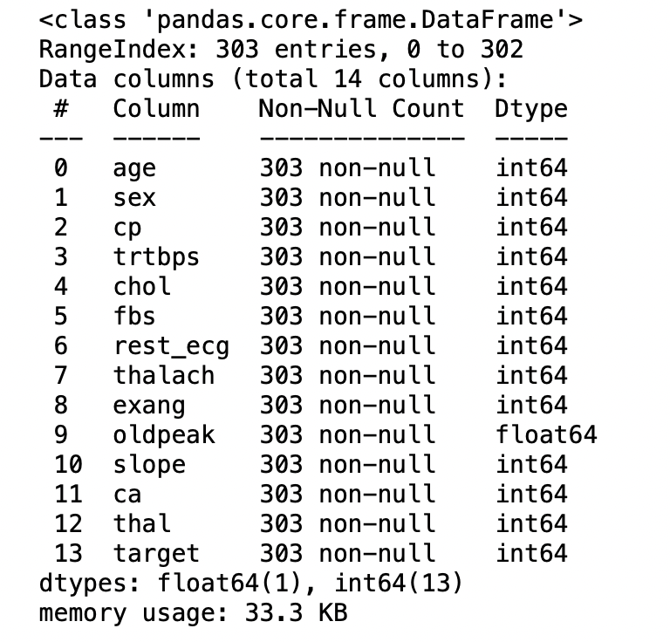
Recognizing Variables
Age: Age of the patient
Sex: Sex of the patient
exang: exercise-induced angina (1 = yes; 0 = no)
ca: number of major vessels (0-3)
cp: Chest Pain type chest pain type
Value 1: typical angina
Value 2: atypical angina
Value 3: non-anginal pain
Value 4: asymptomatic
trtbps: resting blood pressure (in mm Hg)
chol: cholesterol in mg/dl fetched via BMI sensor
fbs: (fasting blood sugar > 120 mg/dl) (1 = true; 0 = false)
restecg: resting electrocardiographic results
Value 0: normal
Value 1: having ST-T wave abnormality (T wave inversions and/or ST elevation or depression of > 0.05 mV)
Value 2: showing probable or definite left ventricular hypertrophy by Estes' criteria
thalach: maximum heart rate achieved
target: 0= less chance of heart attack 1= more chance of heart attack

Slide 11
04
Exploratory Data Analysis

Slide 12
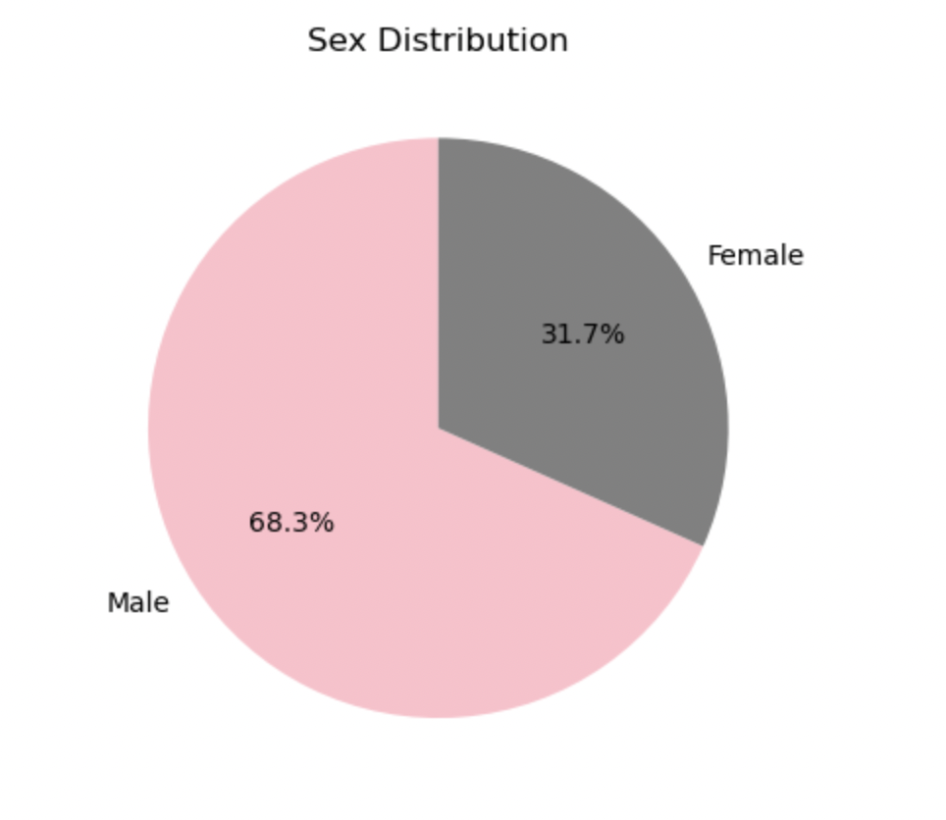
68.3% of the patients are male, 31.7% are female.
So, the number of male patients is more than twice that of female patients.

Slide 13
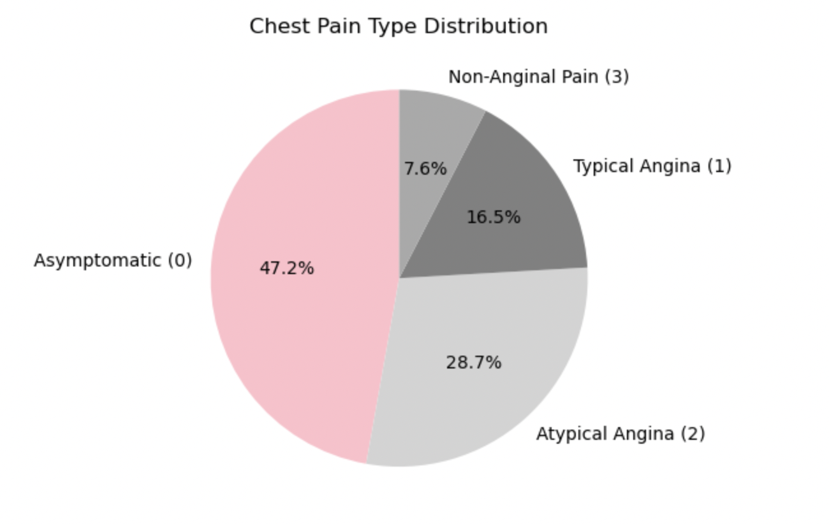
Almost half of the patients have an observation value of 0. In other words, there is asymptomatic angina
Half of the patients are asymptomatic; they have pain without symptoms.

Slide 14
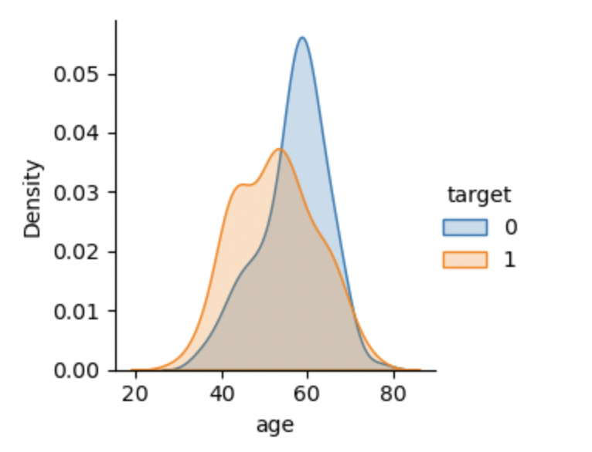
The general belief is that heart attack increases with age.
However, the graph tells us that we are wrong about this. the number of people at risk of heart attack decreases as age progresses.

Slide 15
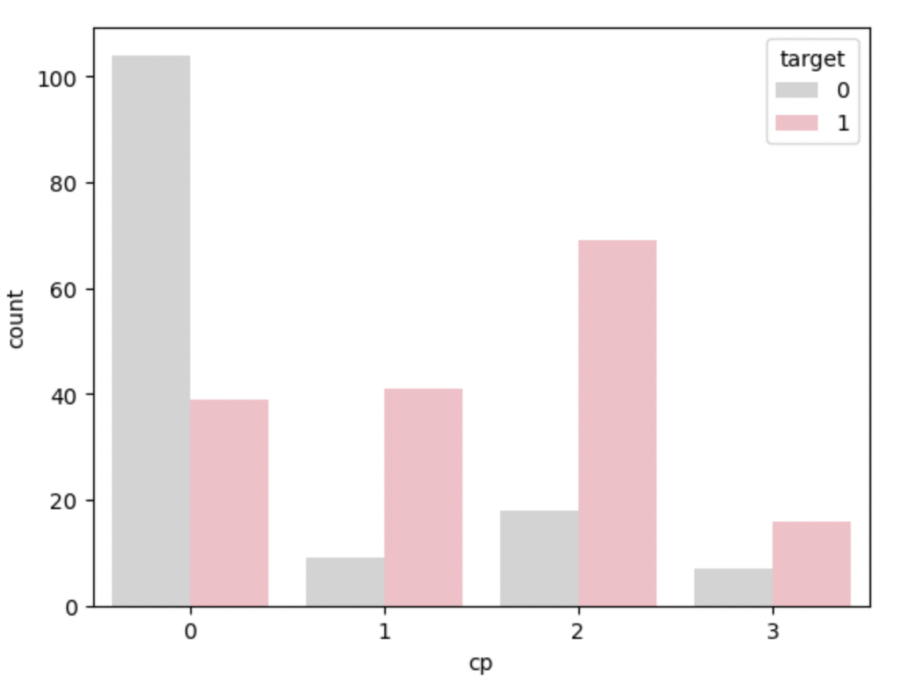
Patients with asymptomatic pains pain are less likely to have a heart attack. When we look at the probability of not having a heart attack, we can say that it is almost three times the other.
In summary, If a patient's "cp" variable is 1, 2, or 3, we can say that the risk of heart attack is high
asymptomatic
non-anginal pain
atypical angina
typical angina

Slide 16
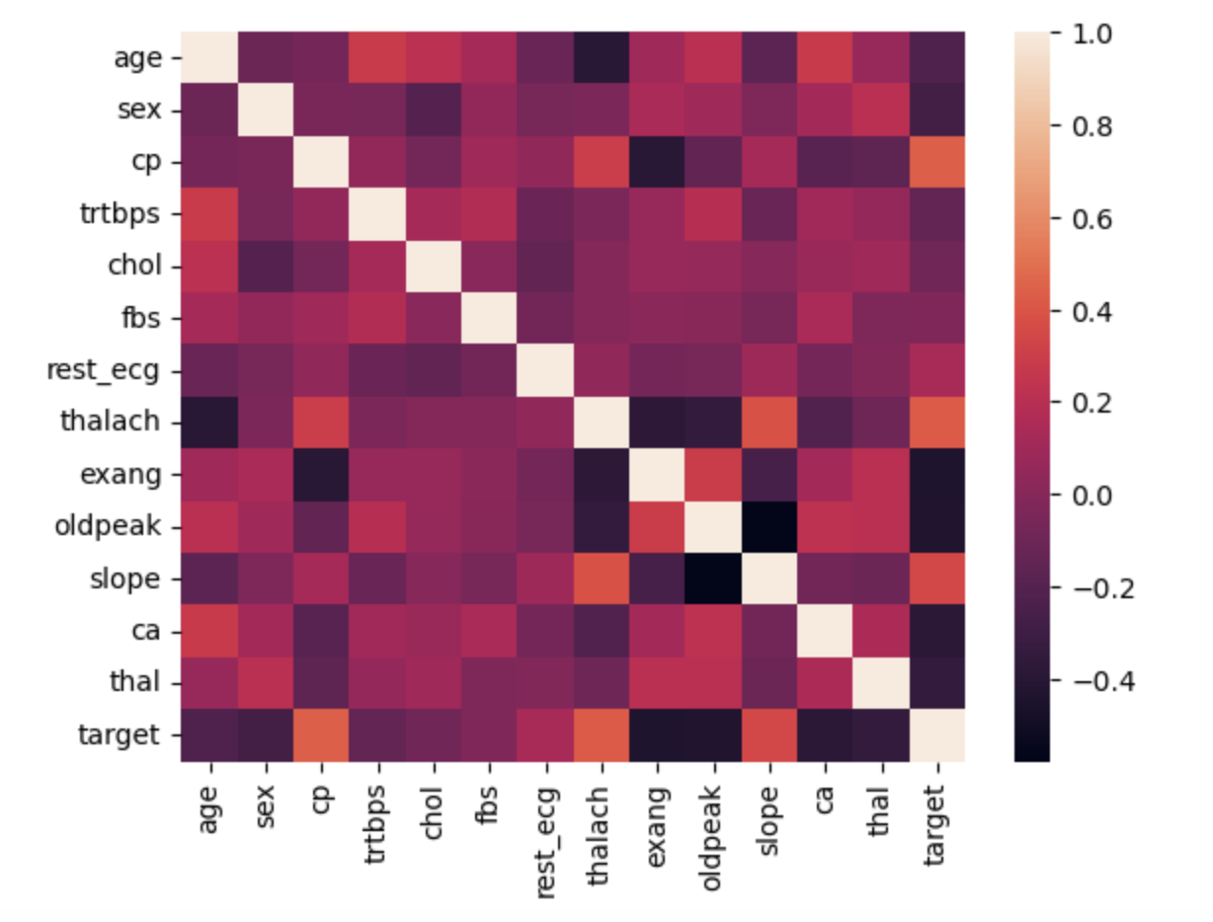
Not a single factor is significantly driving heart attack but all of them combined makes a big impact on the heart.

Slide 17
05
Model Performance

Slide 18
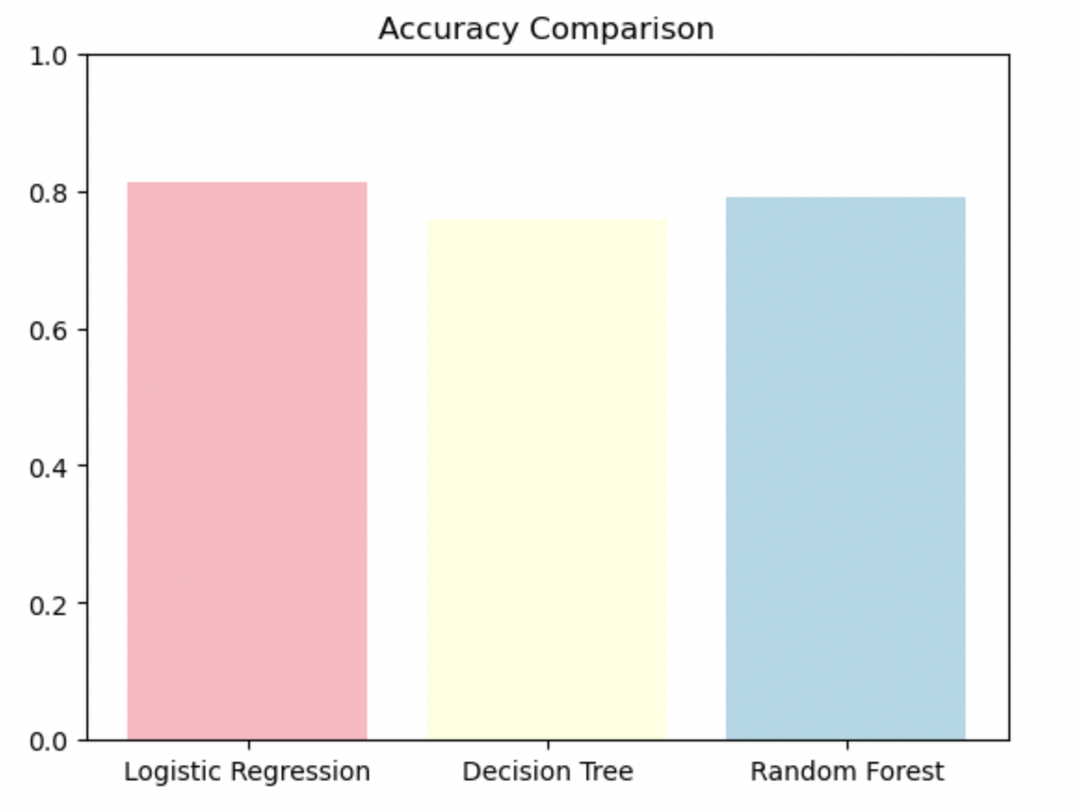
Logistic regression emerges as the frontrunner with the highest accuracy score of approximately 81%, showcasing its efficacy in predicting heart attacks. In contrast, the decision tree model exhibits a moderately lower accuracy score of around 75%

Slide 19
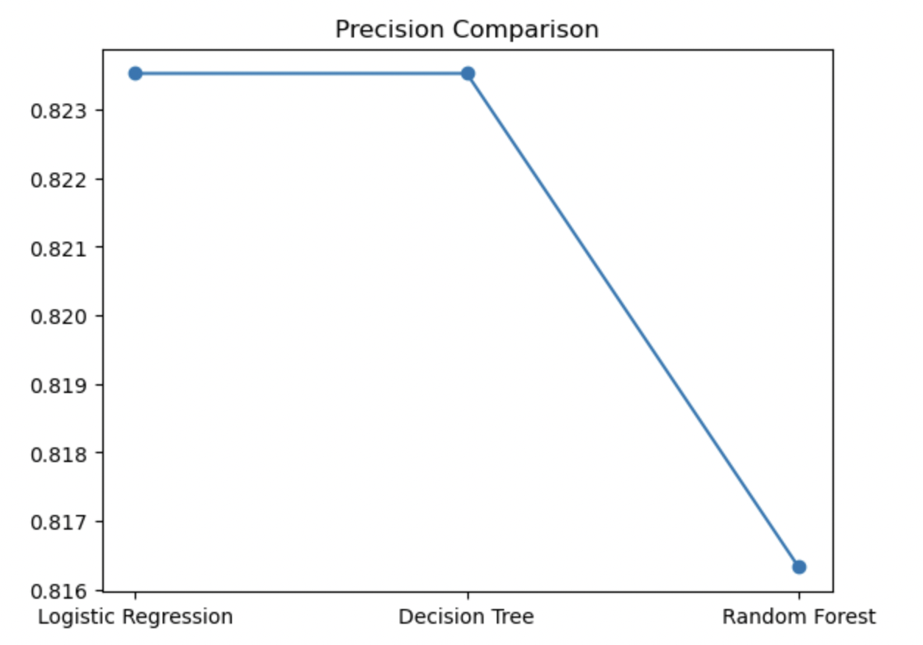
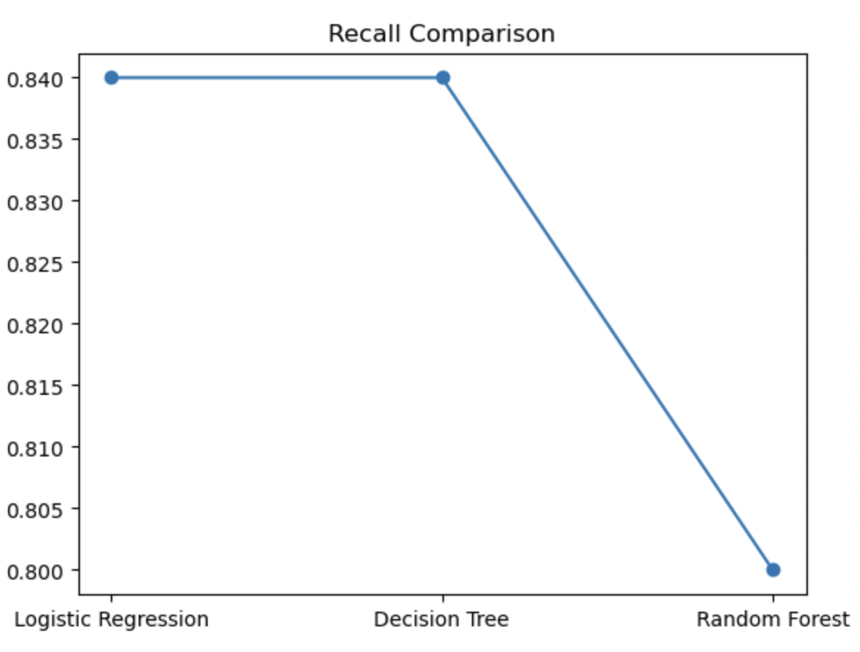
Logistic Regression and Decision Tree exhibit comparable precision scores of around 82%, indicating similar ability to identify individuals at risk of heart attacks accurately. Random Forest is lowest.
Logistic Regression and Decision Tree show identical recall scores of 84%, indicating a similar ability to correctly identify individuals who had a heart attack. Random forest is lowest

Slide 20
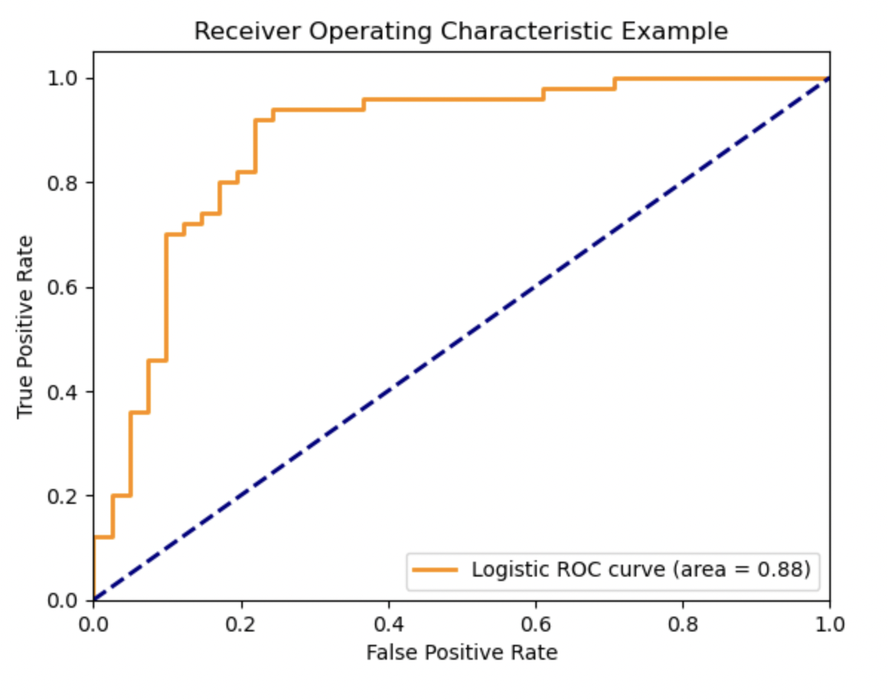
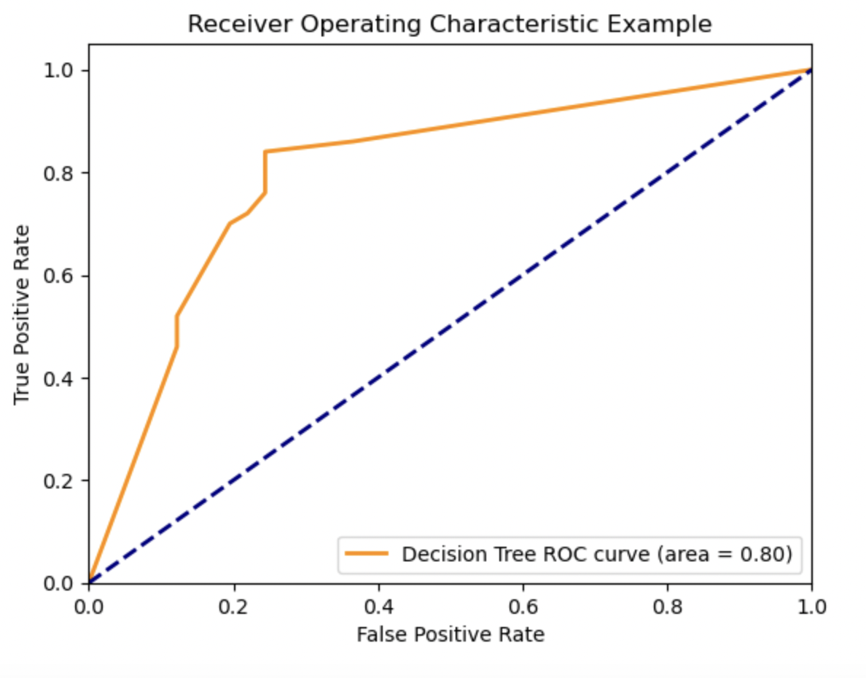
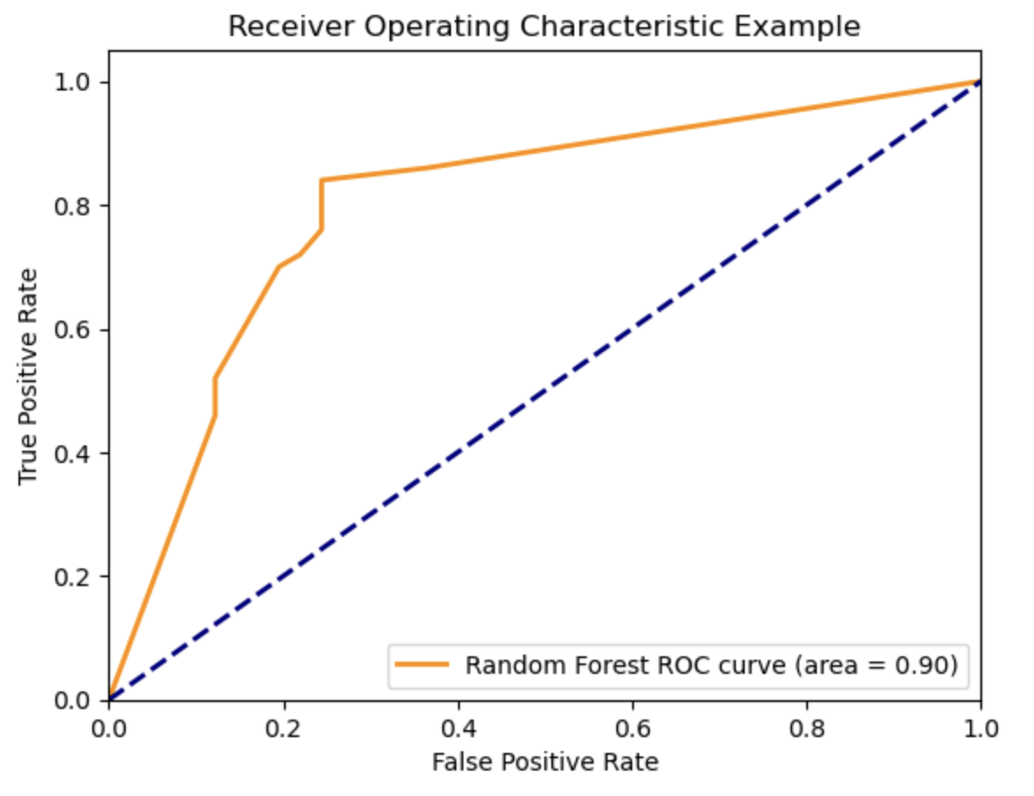
The logistic regression model achieved an AUC score of 88%, indicating strong predictive power. The decision tree model scored slightly lower at 80%, while the random forest classifier outperformed both with an impressive 90% AUC score, showcasing its superior predictive performance.

Slide 21
Model Evaluation
Logistic Regression:
Accuracy: 81%
AUC: 88%
Decision Tree:
Accuracy: 75%
AUC: 80%
Random Forest Classifier:
Accuracy: 79%
AUC: 90%
Random Forest Classifier stands out with the highest AUC score of 90% and a competitive accuracy score of 79%. This indicates that the Random Forest Classifier not only predicts accurately but also has a strong ability to differentiate between individuals at risk of heart attacks and those who are not. Therefore, based on both AUC and accuracy, the Random Forest Classifier appears to be the preferred choice for predicting heart attacks in this context.

Slide 22
06
Business Implication

Slide 23
Early Detection: Identifying subtle patterns and risk factors for early detection of cardiovascular diseases.
Personalized Medicine: Tailoring treatment plans based on individual health profiles.
Efficient Resource Allocation: Prioritizing high-risk patients for preventive care measures, and optimizing hospital resources.
Continuous Learning: Ability to adapt and evolve for continuous improvement.

Slide 24
“Let your heart be your guide, for within its beat lies the wisdom of a lifetime.”

Slide 25

Conclusions
Regular check-ups promote heart health, reducing disease risk.
Diet, exercise, and stress management are crucial for heart health.
Monitoring blood pressure and cholesterol aids early detection.
Prompt medical attention manages potential cardiac issues.
Embrace recommendations to control heart health for better well-being.

Slide 26
Thank You

